Slide 1

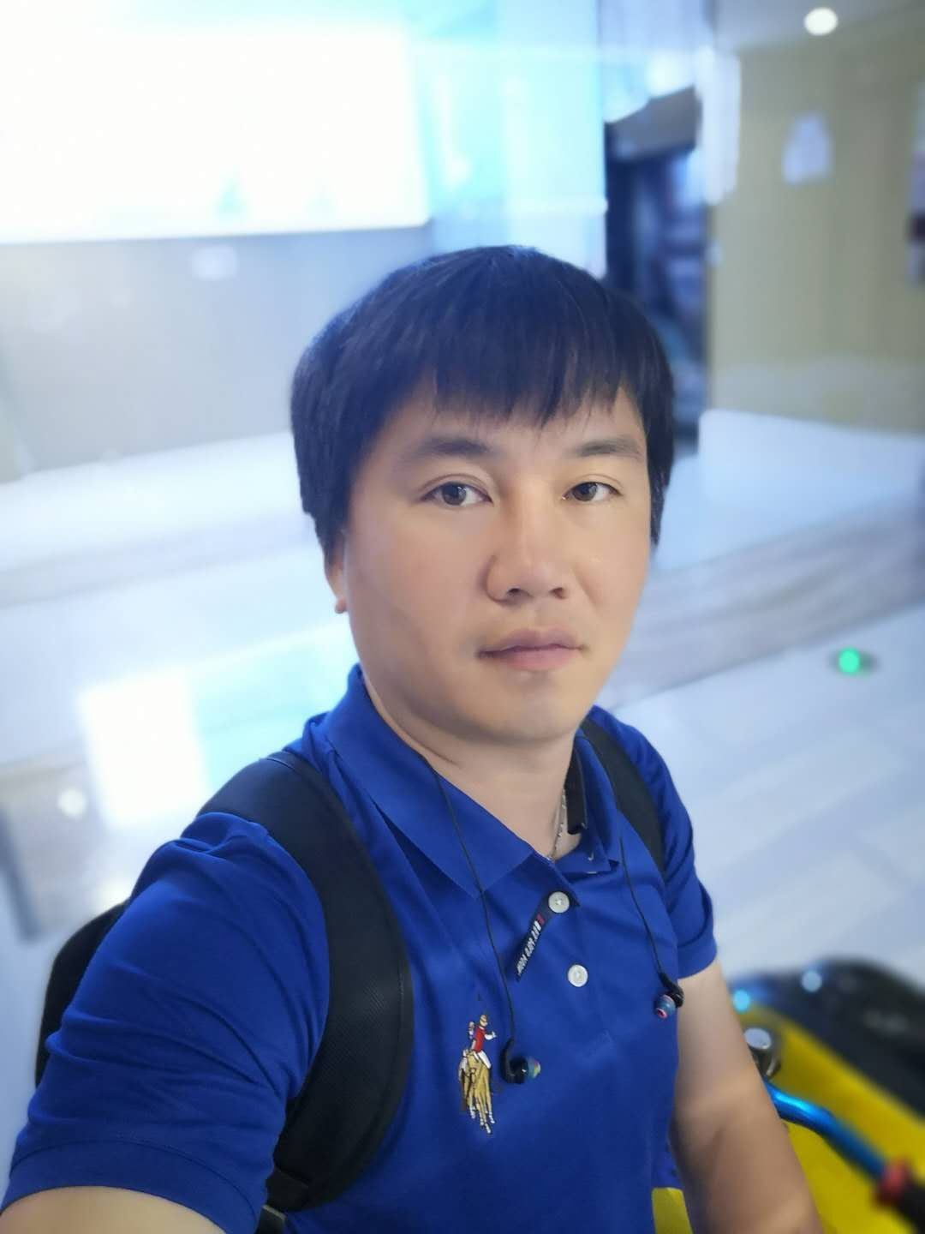

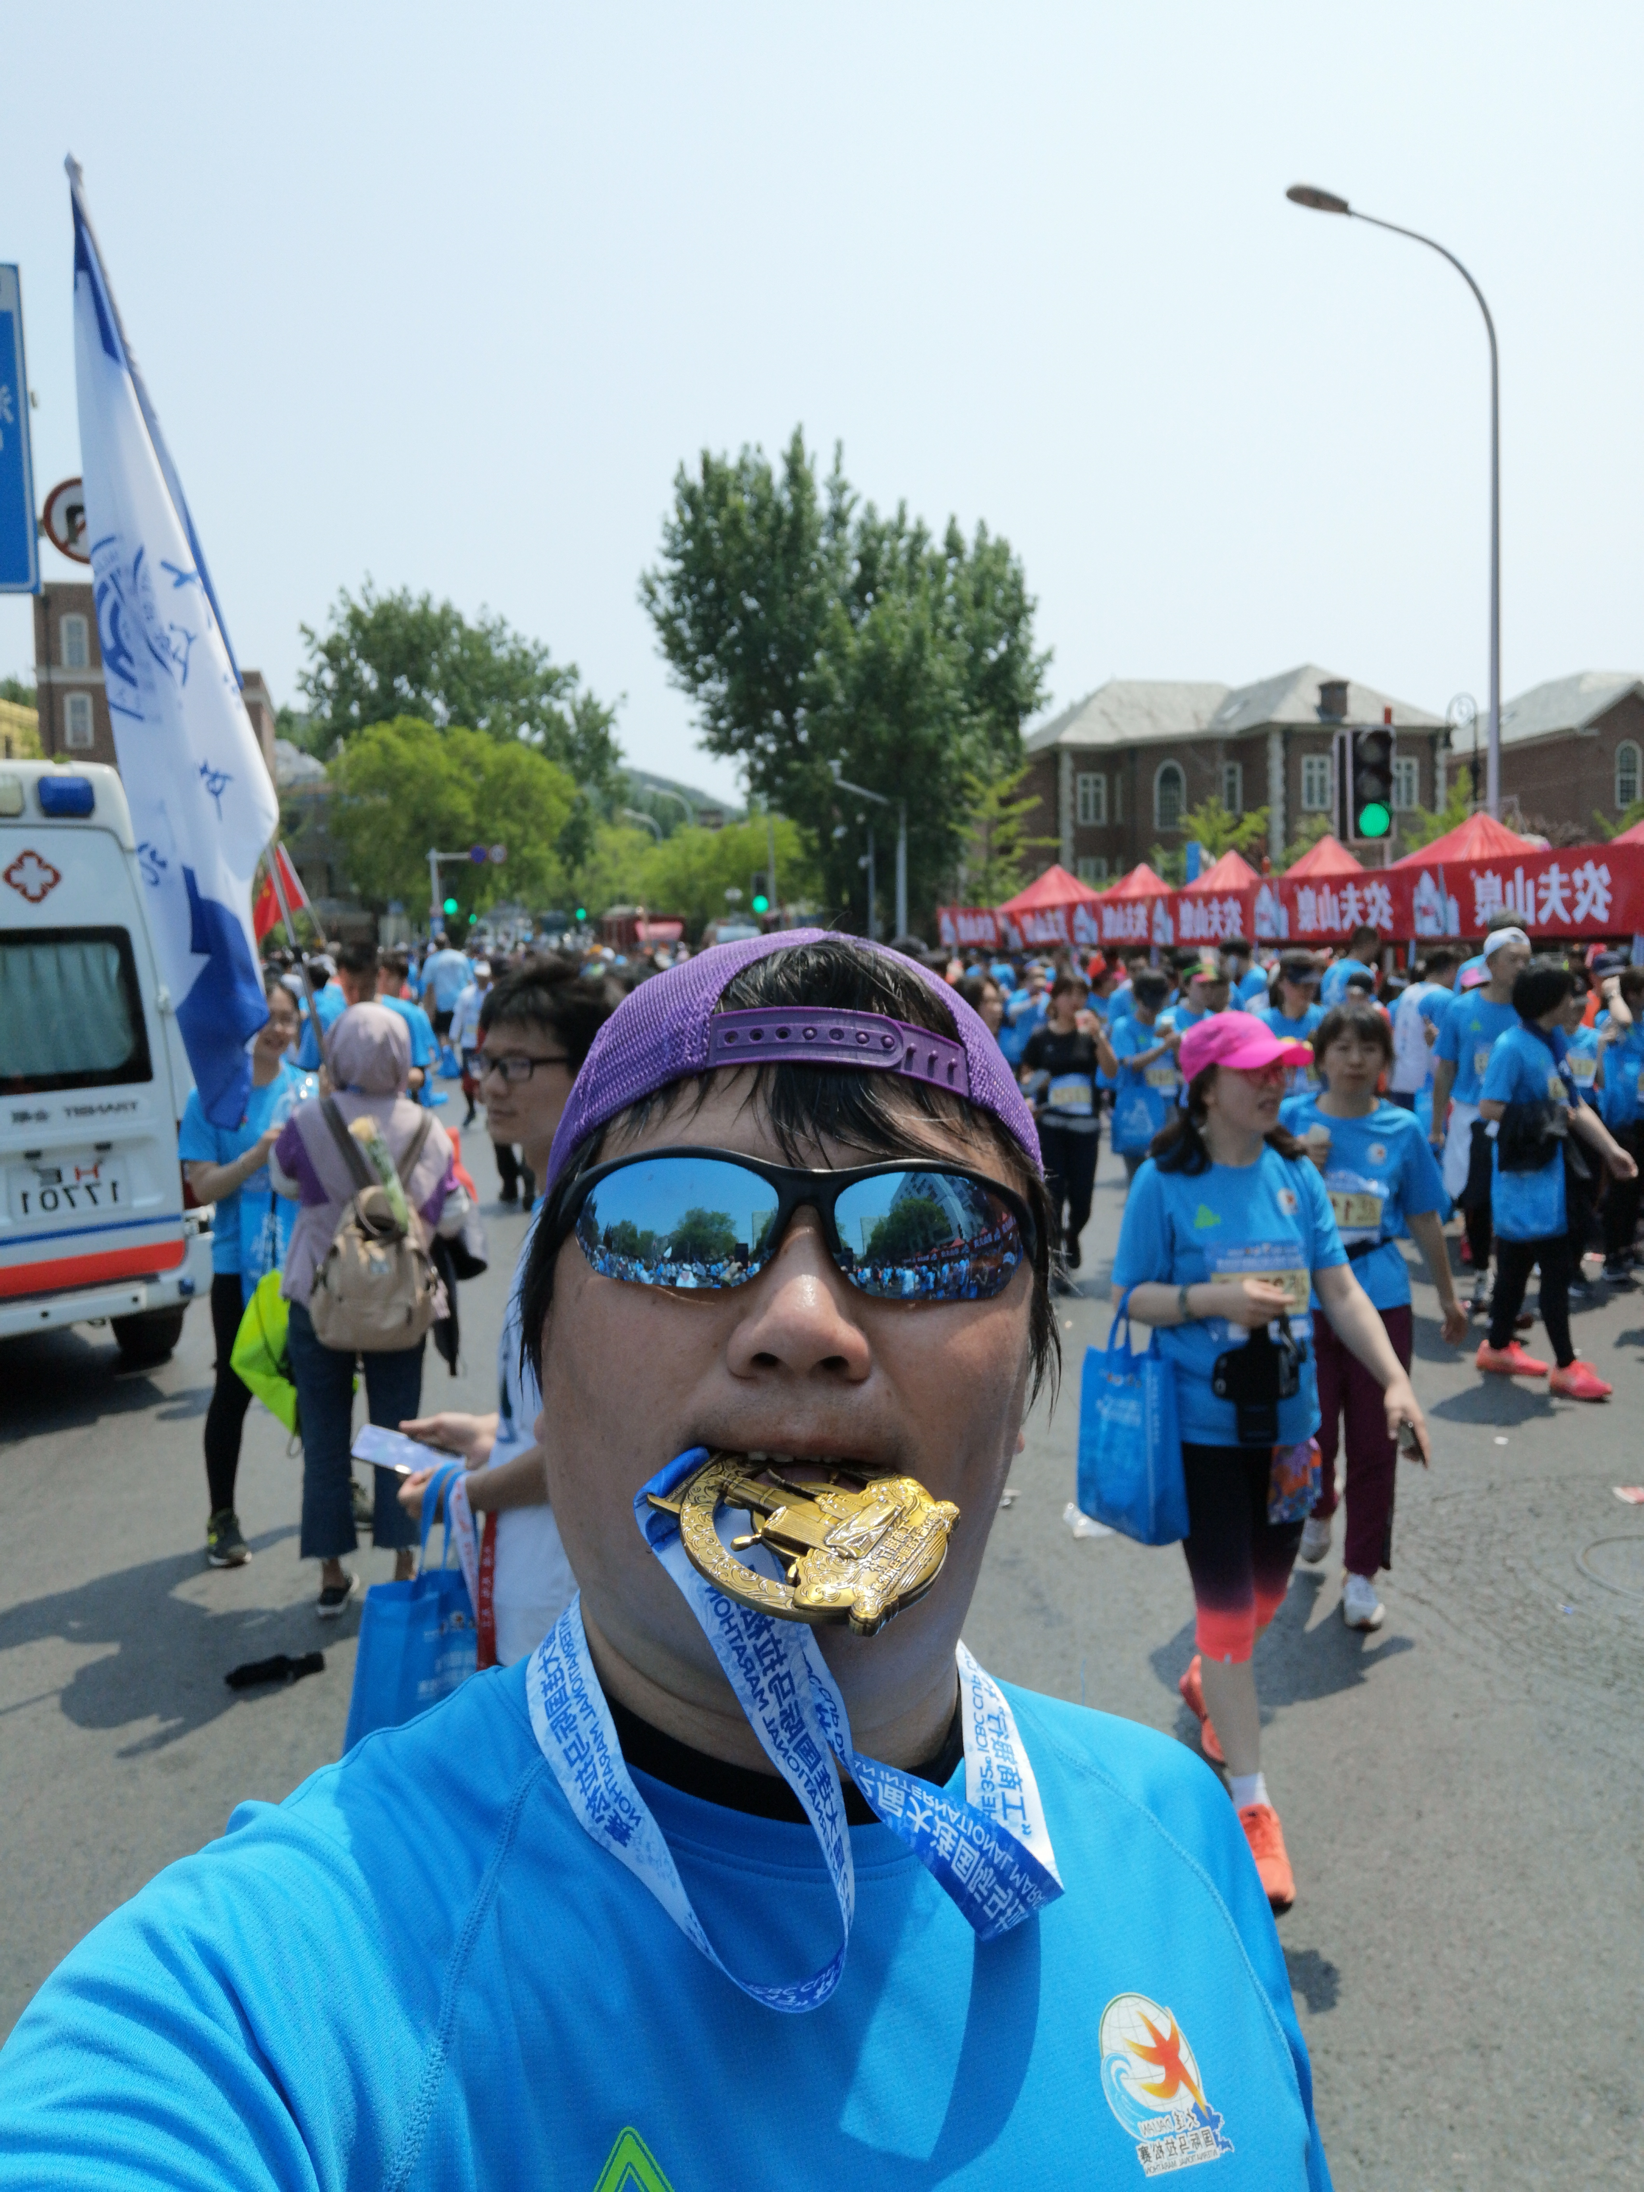



Introductions
Cui, Richard CHIKUN
  Photo
  Position / Level: CIO Rapid TA Lead, Tech Arch Delivery Manager
  Years with Accenture: 7 years (2015-2022)
  MTA Certification: Accenture Certified Senior Architect
  Office: Dalian 29#3W
  Technology Architecture Experience
    Certified TOGAF, AWS Cloud Solution Architect
    TA of CCMT (4911), LMAT (7077), SET (6684), Navigator (10230), CIP (7821), ESS (9409), IPAMC (9606), SQLAO (9353), CIP (7821)
  Fun facts
    5-year-old boy’s father, Kayaking, Snowboard, Half-Marathon
Notes:
Focus
Provide more details about yourself to the participants.
Notes
FACULTY MUST COMPLETE THIS SLIDE PRIOR TO GIVING THE PRESENTATION.
The placeholders on this slide are suggestions for information to provide to participants.
Include your Master Technology Architect program certification level. You may remove or replace these placeholders with other information as you see fit. All faculty members should introduce themselves to the class.
For Technology Architecture Experience, list or inform the participants of the following:
Explain why you chose to become a Technology Architect.
Describe what you enjoy about being a Technology Architect.
How many years you’ve worked as a Technology Architect.

